Slide 1
Final Project
Team 4

Slide 2
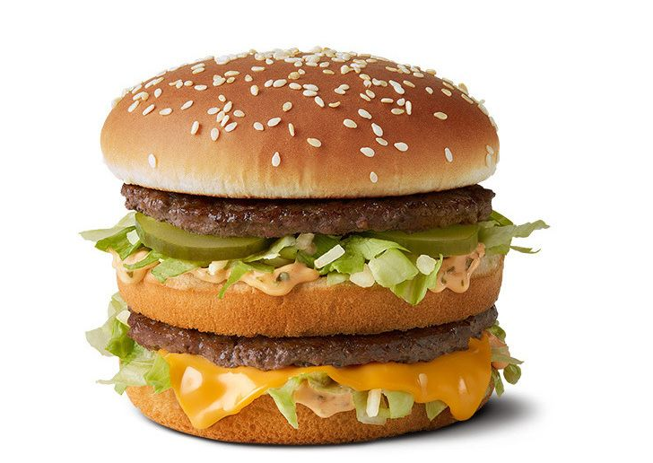
Overview of Project
Create an overview of the cost of a Big Mac from McDonalds and match that data against annual GDP of Nation

Slide 3
Questions:
How does the price of BigMac correlate with the GDP (worldwide) over time (2000-2021)?

Slide 4

Database

Slide 5
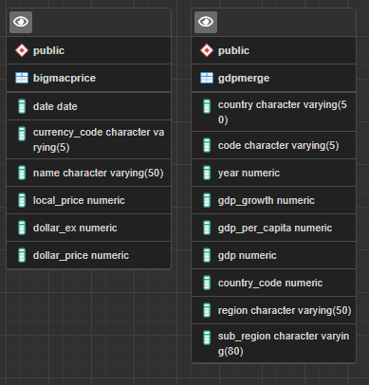
Data
Datasets
The datasets are from Kaggle and World Bank:
GDP Data (1960-2016)
GDP Data (1920-2020)
Big Mac Data (2000-2022)
Region(continent) Data

Slide 6
Databases
AWS (tbd)
pgAdmin

Slide 7
Machine Learning

Slide 8
Objective
Which country(top 5) have the largest cost increase?
Which country(top 5) have the smallest cost increase?
Which region has the highest cost increase?
Which region has the lowest cost increase?
How does the price correlate with the top and bottom 50 GDP’s?

